Slide 1
Project: AI-Assist Document Quality checker
Problem
Manual document reviews are repetitive, time-consuming, and prone to errors. Common issues: heading hierarchy, captions, formatting, numbering, TODOs, terminology.
Who it affects
Technical Writers
Documentation Engineers
Reviewers
Input
Microsoft Word (.docx) technical document
Output
HTML quality report with actionable recommendations
Success
Reduce manual review effort with consistent automated pre-review.

Slide 2
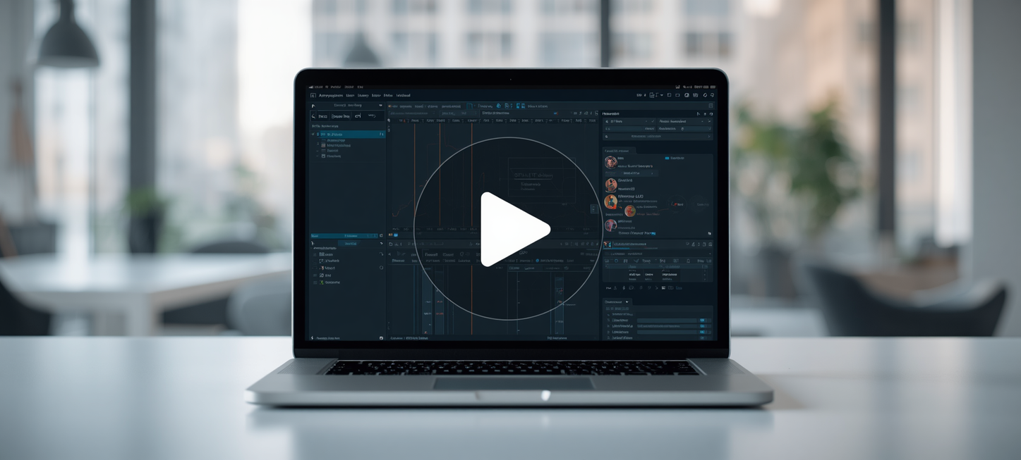
Demo Video
Watch proof-of-concept in action. A 2-minute demo showing real input producing real output.
Demo Link

Slide 3
Learnings
Learnings
Configured the development environment using Git, Python, Java, Node.js, Claude Desktop, and Cursor.
Developed a custom AI skill for document quality checking.
Built and configured a custom MCP (Model Context Protocol) server.
Integrated the MCP server with an AI assistant to automate documentation review.
Gained hands-on experience in prompt engineering, tool integration, debugging, and end-to-end workflow development.
Key Outcome
Automated review that improves documentation quality and reduces review time.
VIEW REPO
Thank You

